Slide 2
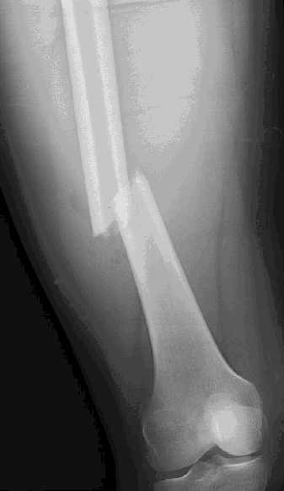
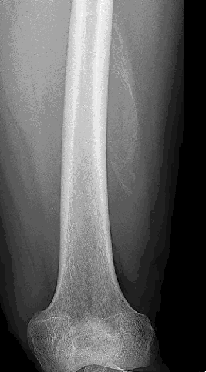
Vergelijkingen
met breuken
Hoe raak je ze kwijt?

Slide 3
2
3
2 ⋅ 3
3
2 ⋅ 3
3
⋅ 3 =
=
= 2
5
8
5 ⋅ 8
8
5 ⋅ 8
8
⋅ 8 =
=
= 5
6
x
6 ⋅ x
x
6 ⋅ x
x
⋅ x =
=
= 6
12
x + 1
12 ⋅ (x + 1)
x + 1
12 ⋅ (x + 1)
x + 1
⋅ (x + 1) =
=
= 12

Slide 4
Vergelijking:
Los op:
12
x
+ 8 = 4x
Vermenigvuldig alles met x
12
x
⋅ x + 8 ⋅ x = 4x ⋅ x
12 + 8x = 4x²
x² – 2x – 3 = 0
(x – 3)(x + 1) = 0
x = 3 ∨ x = -1

Slide 5
24
x − 1
6
x
− 3 =
Vermenigvuldig alles met (x – 1)
24
x − 1
6
x
· (x – 1)
− 3(x – 1) =
· (x – 1)
6(x – 1)
x
24 – 3x + 3 =
Vermenigvuldig alles met x
6(x – 1)
x
24x – 3x² + 3x =
· x
27x – 3x² = 6x − 6
3x² + 21x + 6 = 0
En nou kunnen we het verder wel……

