Slide 1

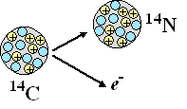
stabiel
stabiel

Slide 2
Halfwaardetijd 5730 jaar
N = N₀ ⋅ g^{t}
g = 0,99899…

Slide 3


Slide 4









Slide 5
N = N₀ ⋅ 0,99899^{t}
0,8 ⋅ 10⁻¹² = 1,2 ⋅ 10⁻¹² ⋅ 0,99899^{t}
0,67 = 0,99899^{t}
t ≈ 400 jaar

Slide 6
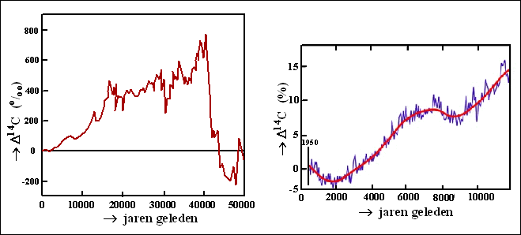

Slide 7
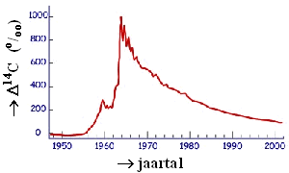

Slide 8
